Slide 1

Real Time and Adaptive Gamer Type Classification on Space War
ChemEng

Slide 2
Chem Eng Members
02
03
Pongsarat C.
Nidchapan N.
Saranchai A.
6310412018
6310412022
6310412024

Slide 3
Contents
Game: Space War
Project Objective
Model in detail
Suggestion

Slide 4
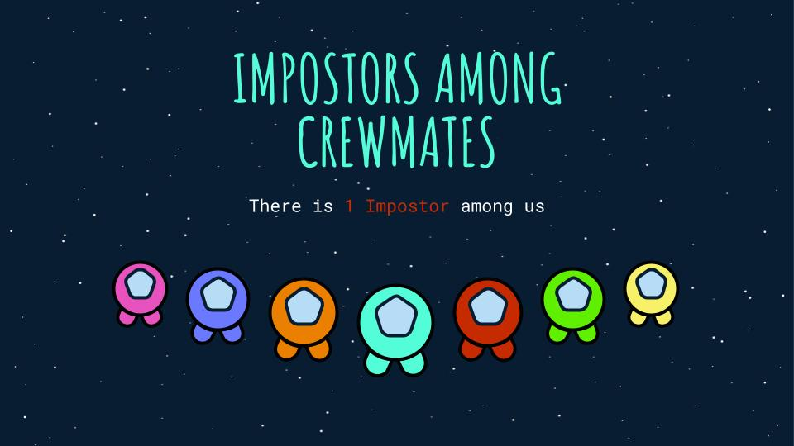
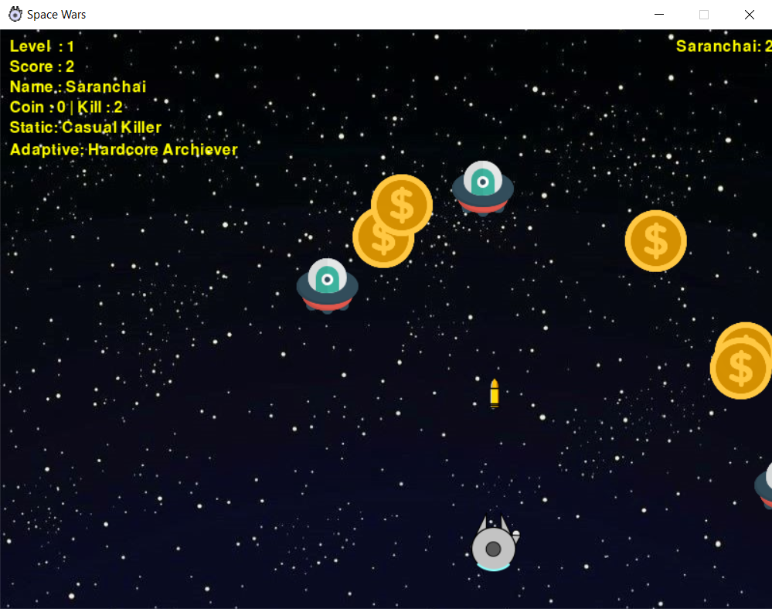
Game: Space War
Space war game is a spacecraft shooting game with an objective to kill enemy or collect the coin as much as possible to gain the highest score

Slide 5
Project Objective
To make a real time and adaptive classification model that instantaneously classify the player to the most suit gamer type based on their playing style in real time
As the game progresses, the model will
make a gamer type prediction
learn by itself from fresh player data
Gamer type divided into 4 classes: “Hardcore Killer”, “Hardcore Achiever”, “Casual Killer” and “Casual Achiever”

Slide 6
Model Overview
Let model predict the player’s cluster and gamer type
Let model learn
new the feature
Prepare the game feature
Step 1
Step 2
Step 3
After every 240 game loop passed,
the model will make a prediction and learning by itself again

Slide 7

Model Selection
Model | Reason
CluStream | Less adaptive comparing to Incremental Kmeans from trial
Incremental Kmeans | More adaptive comparing to CluStream from trial
StreamKMeans | Incompatible with Space War game (error)

Slide 8
Available Features
Variable | Description
A0 | Average position in X axis
A1 | Average position in Y axis
A2 | Total number of coins collected
A3 | Total number of destroyed enemies
A4 | Total number of shots
A5 | Total number of shots without enemies (A4 - A3)
A6 | Level reach
A7 | Key X pressed count
A8 | Key Y pressed count
A9* | Number of enemy created
A10* | Number of coin created
* The value of the feature is not align with the actual game play

Slide 9
Feature Selection
Variable | Description | Calculation
Amount of coin increase | Number of enemy kill increase within 240 game loop | (Total number of coins collected₂ - Total number of coins collected₁)
Amount of kill increase | Number of coin increase within 240 game loop | (Total number of destroyed enemies₂ -Total number of destroyed enemies₁)
1
2
After 240 game loop passed
Number 240 tends to give a best model adaptivity compare to 120 and 360 (judged by team)

Slide 10
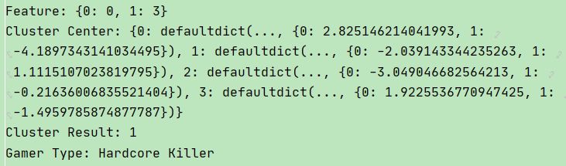
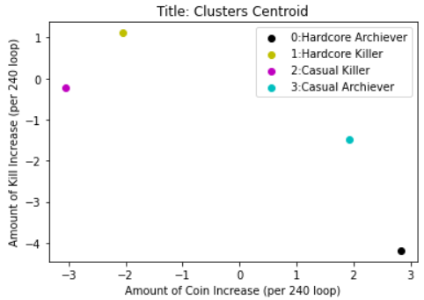
Player Classification
Amount of coin increase and Amount of kill increase are used as a model feature
The centroid of each cluster will be represented as Amount of Coin increase(x) and Amount of kill increase(y) coordinate
The cluster with highest y-centroid will be assigned to “Hardcore Killer”
Notes:
The model prioritize the kill over the coin

Slide 11
Player Classification
In a similar way, the cluster with highest x-centroid will be assigned to “Hardcore Achiever”
(If the highest x-centroid cluster is the same one as highest y-centroid the second highest x-centroid will be assign instead)
The cluster which has a higher x-centroid from the last two will be assigned to “Casual Killer” and the last cluster will be “Casual Achiever”

Slide 12
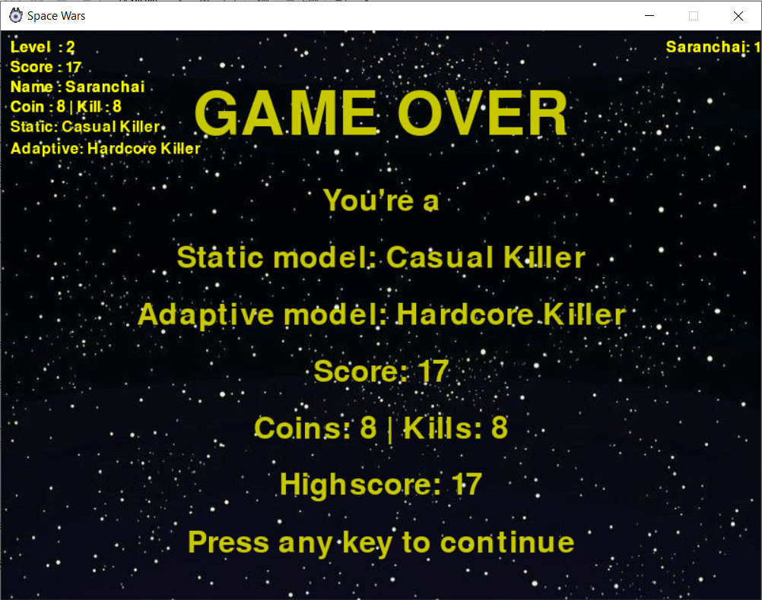
Game Over Player Classification
Every time the model predicts the player type, the data will be recorded
Final player type is the most assigned player type
After the game over, the result of final player type will be shown on the game over screen

Slide 13
Results
Player | Quest. | Trial 1 |  | Trial 2 |  | Trial 3
A0 | A0 | Static | Adaptive | Static | Adaptive | Static | Adaptive
Pongsarat | HA | HK | HA | HA | HA | HA | HA
Nidchapan | CA | HK | HK | HK | HK | HK | HK
Saranchai | CA | HA | HK | HA | HK | HA | HK
Model | Accuracy
Static | 22.22%
Adaptive | 33.33%
HK = Hardcore Killer
HA = Hardcore Achiever
CK = Casual Killer
CA = Casual Achiever

Slide 14
Suggestion
Use better model feature such as %coin collected and %enemy killed in a period of time
%coin collected = #coin collected / #coin respawn
(in a period of time)
%enemy killed = #enemy killed / #enemy respawn
(in a period of time)
Notice that, as a game level increase, it is hard to survive the game without killing a lot of enemy and this could lead the model to assign the most players as “Hardcore Killer”

Slide 15
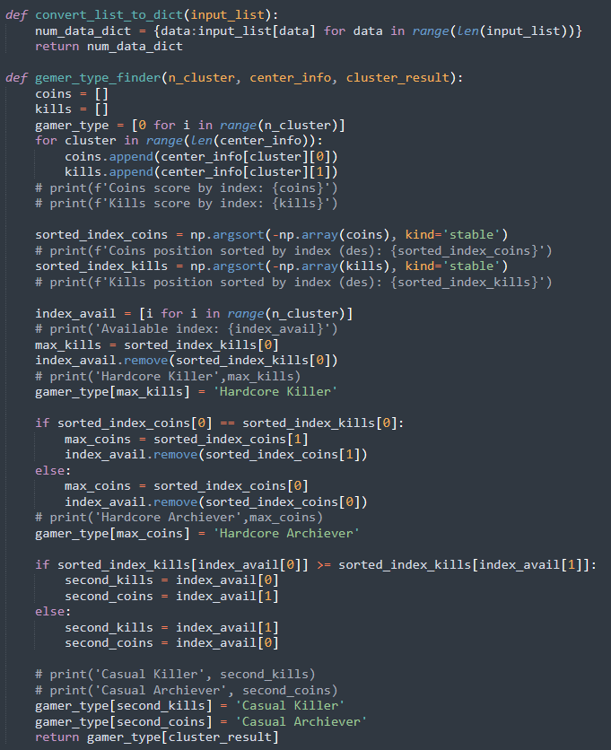
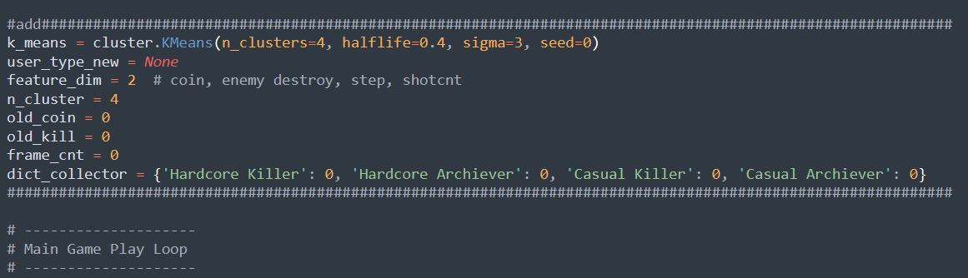
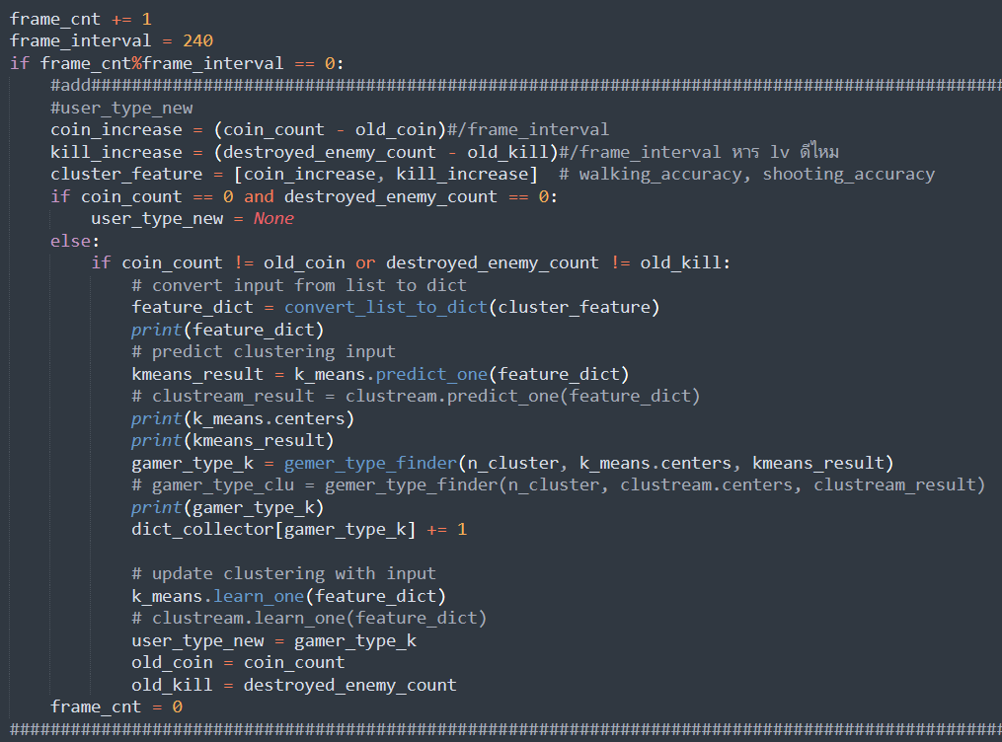
Code

Slide 16
Thanks!
Do you have any questions?

Slide 17
Video Example

